Slide 1
IT Jobs in 2040
A look at the Future of IT
Hugh R and Carson A

Slide 2


Slide 3
Table of Contents
Introduction
IT Jobs Timeline
IT Roles in 2010 vs 2025
Hardware Evolution 2010-2025
Software Evolution 2010-2025
Salary Evolution 2010-2025
Drivers of Change
Intro into the Future
New Jobs in 2040
Mainstays
Conclusion
Bibliography

Slide 4
Introduction
As technology evolves, so do the careers that support it. This presentation will explore what IT jobs will look like in 15 years. To do this we will discuss how the field has changed in the past 15 years and then try to extrapolate based on current technology.
As AI, reliance on the cloud, and automation continue to grow how will the workforce be shaped.

Slide 5
IT Jobs Timeline
2010
2015
2020
2025
2030
2035
2040
HTML5 Developer
Mobile app Developer
Cloud Engineer
AI Prompt Engineer
AI Safety Compliance technicians
Bio-Interface Specialists
Post Quantum
Cybersecurity
The advancement of the internet led to businesses shifting their focus more towards Search Engine Optimization and Search Engine Marketing.
The growth of the smartphone enabled businesses to be more efficient, but needed people to develop applications for business purposes.
The rise of cloud computing created a need for people who can design and expand cloud infrastructure.
The AI Boom in 2023 has introduced a lot of new AI positions to the workforce.
As the government passes legislation on AI restriction and safety there will be a demand for humans to oversee these issues.
As the medical field progresses there will be a blending of professions between the medical field and the IT field.
Quantum Computing is set to cause a paradigm shift in the way we encrypt data. There will be a massive demand for talented cryptography specialists.

Slide 6
IT Roles in 2010 vs 2025
We have seen jobs evolve and branch out but keep a fundamental theme.
2010
2025
Network Administrator | Cloud Infrastructure engineer
Web Developer | Front End, Back End, Full Stack Dev
IT Security Specialist | Cybersecurity Analyst, Pen Tester, Malware Analysis
IT Support | Remote Help Desk, Automation Support

Slide 7
Hardware Evolution 2010-2025
2010: in house servers, HDDs, and Local desktops were the norm
2015: Rise of SSDs, Virtualization-ready CPUs, and energy-efficient data centers.
2020: Explosion of personal and enterprise cloud hardware. GPUs, ARM chips, and IoT devices put a some kind of computer in every room in the modern world.
2025: AI, almost complete adoption of virtual infrastructure.

Slide 8
Software Evolution 2010-2025
2010: Standalone desktop apps, manually installed software, and infrequent updates.
2015: Widespread adoption of software as a service, version control, faster development workflows.
2020: remote collaboration tools, digitized banking, containerization allowing cloud software to run on almost all devices.
2025: AI-integrated everything, no-code platforms, autonomous programming systems.

Slide 9
Salary Evolution 2010-2025
15 years ago most IT jobs that required a degree paid between 50k-70k
Cloud infrastructure management and mobile development pushed them up. DevOps and cloud engineers began earning 100K+
With the rise of remote work and meetings came a rise in the demand for security which created a ton of high paying cyber-security jobs at upwards of 140K.
Data engineering for machine learning and prompt engineering positions start around 120k

Slide 10
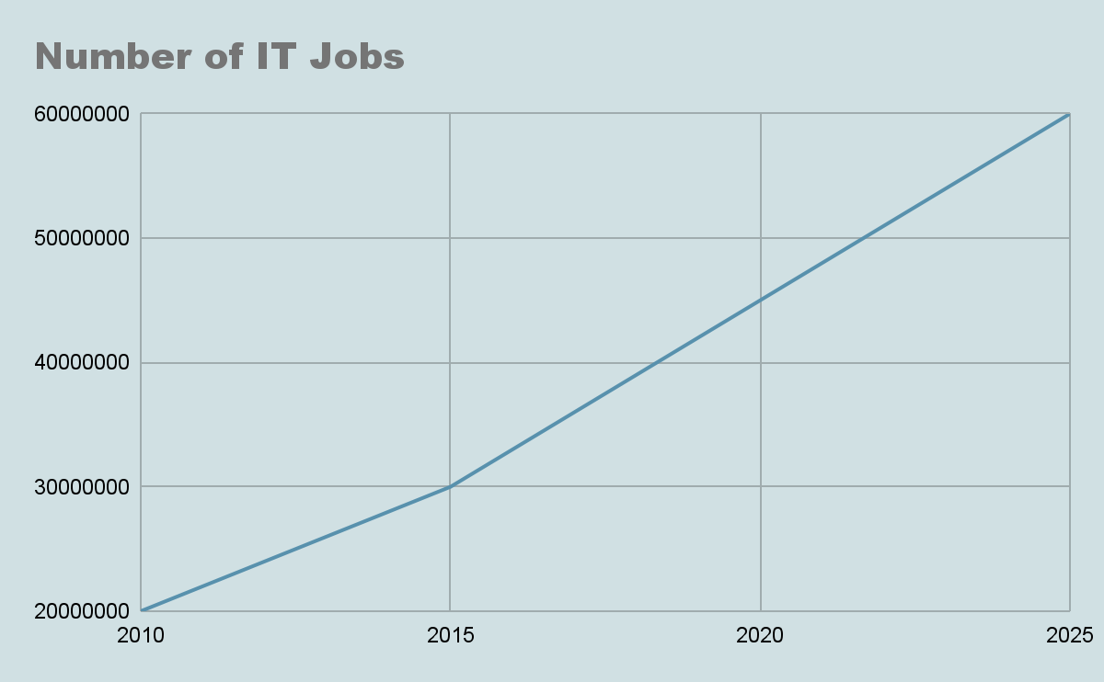
Drivers of Change
As technology progressed some breakthroughs caused huge spikes in the diversity of the IT job market.
There are a few notable breakthroughs:
Smartphone App boom in 2012
Upload speed Increases allowing for cloud adoption
Covid-19 forcing remote work around 2020
AI explosion in 2023

Slide 11
Into the Future
While we can’t actually predict the future there are some change drivers that we can extrapolate to intuitively.
Quantum computing will most likely create a new boom in cyber-security requiring new encryption protocols and a giant panic to secure current systems.
AI as a partner in the workplace instead of a tool.
Ubiquitous high Speed internet allowing true decentralization.
Bio-IT convergence will lead to IT positions in the medical field.
AI safety compliance.

Slide 12
2040 IT Roles Evolved
Cloud Infrastructure engineer | Autonomous System Admin
Front End, Back End, Full Stack Dev | Prompt engineering
Cybersecurity Specialist | Hash-based cryptography engineer, Legacy System recovery
Remote Help Desk | Mostly phased out

Slide 13
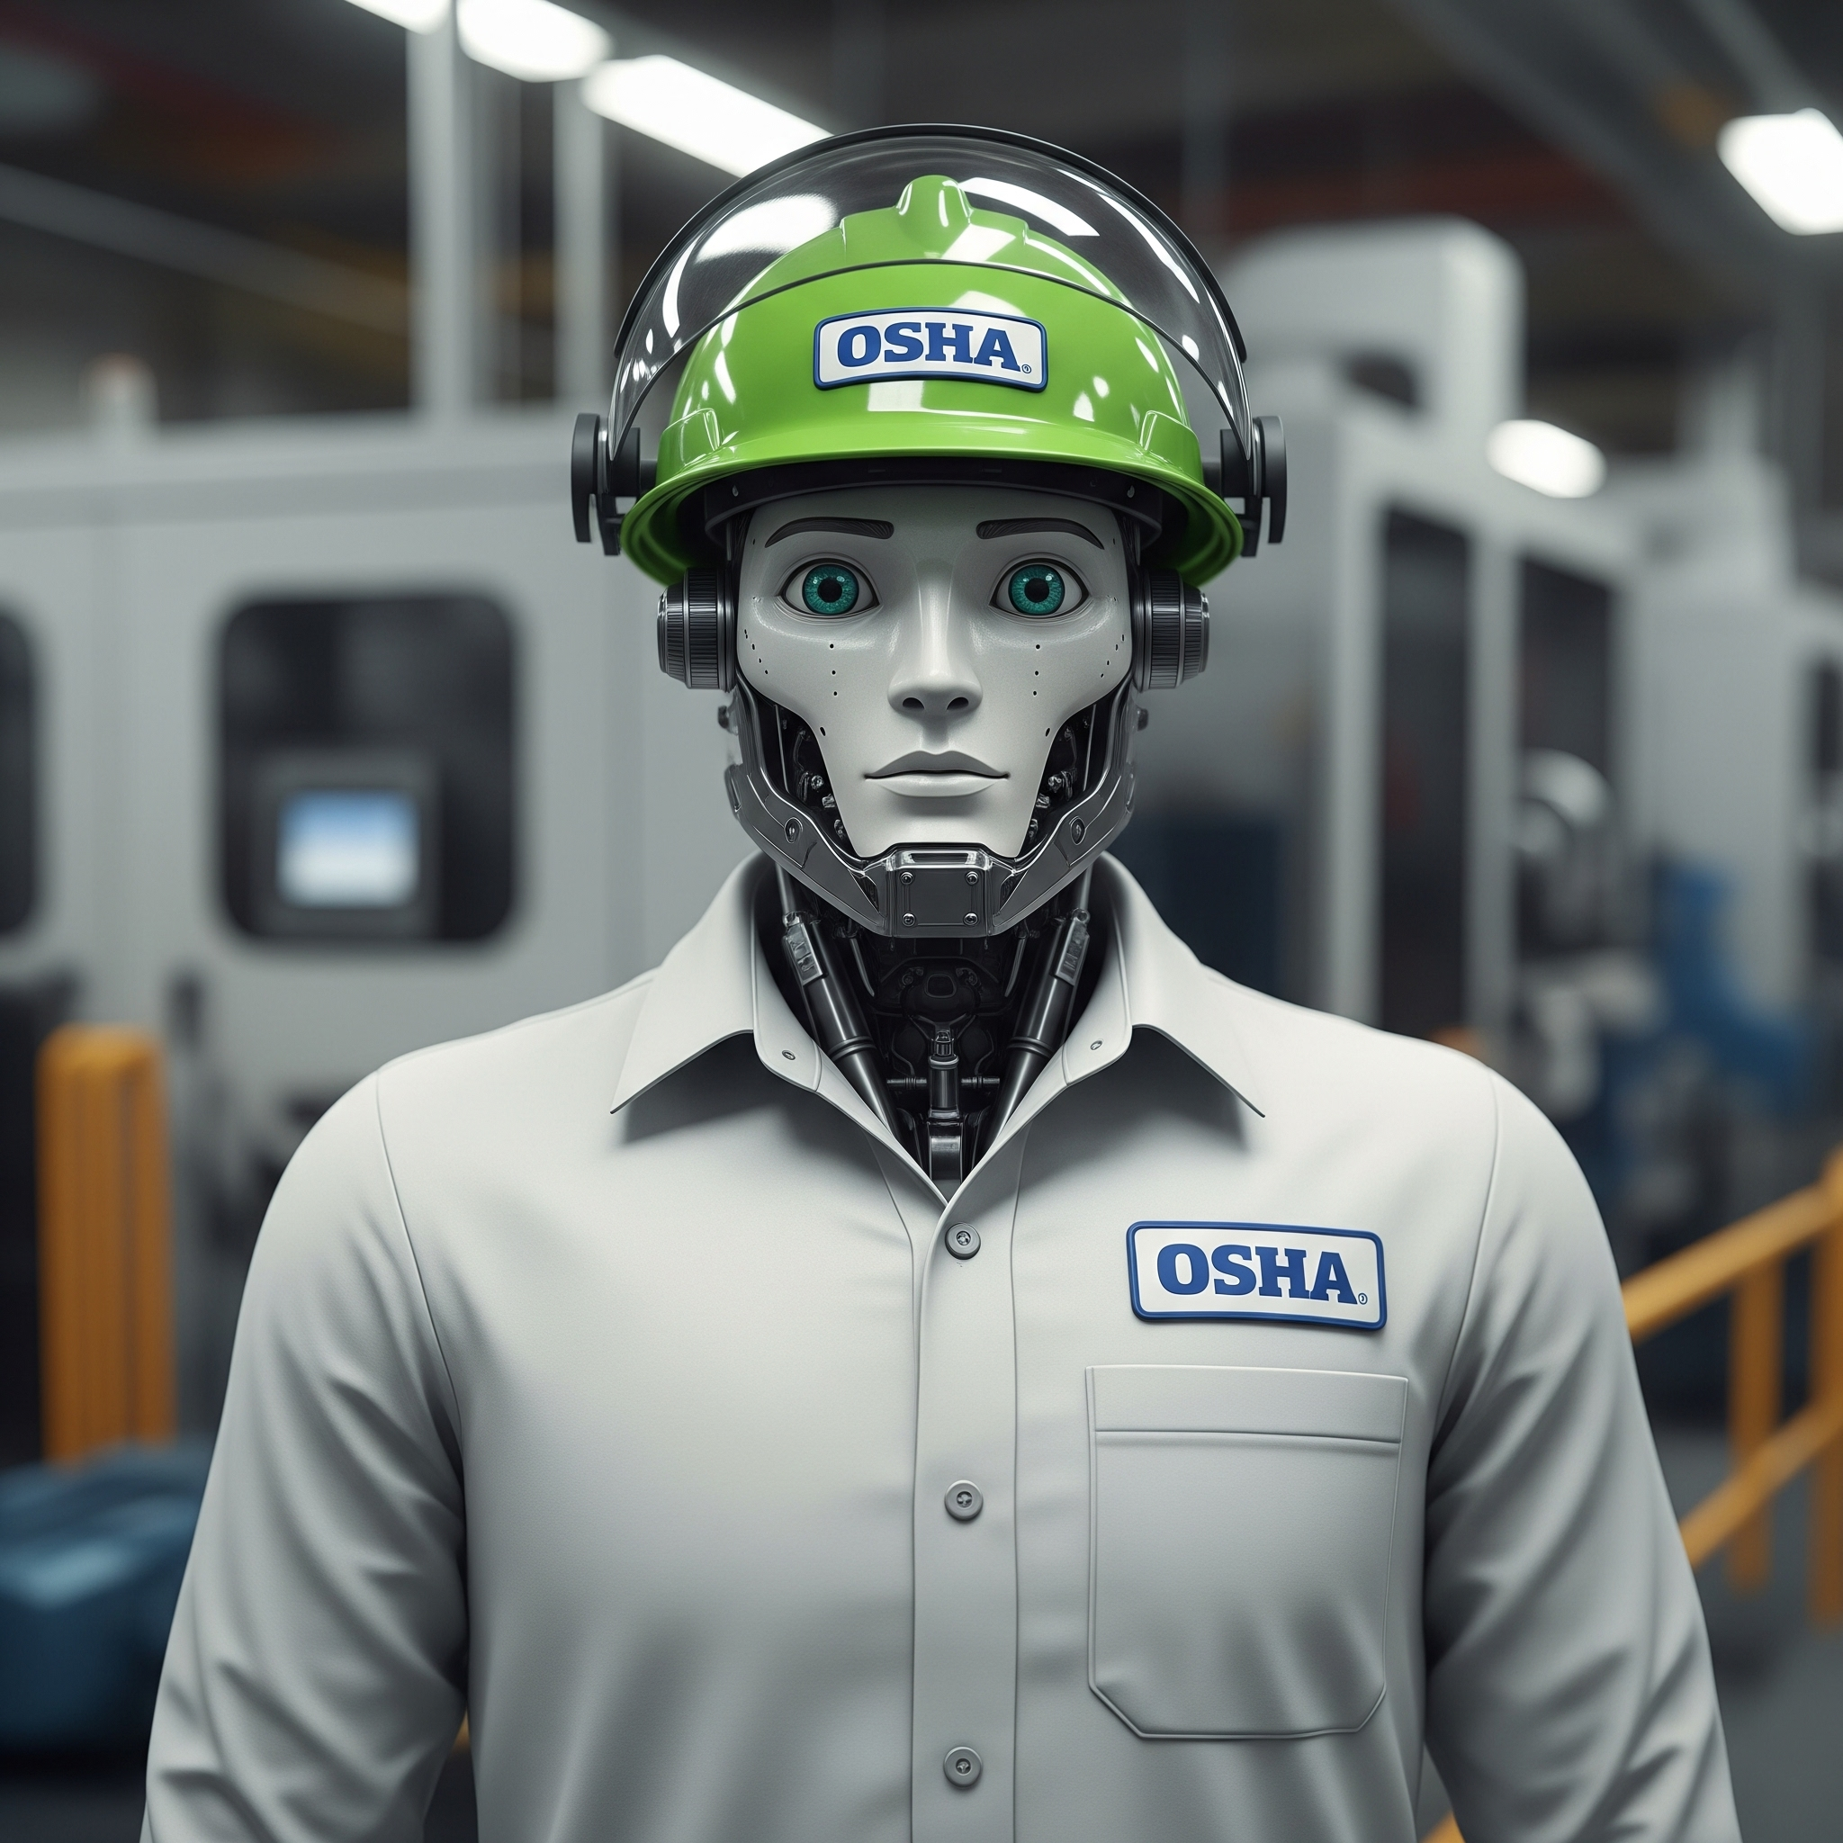
New jobs in 2040
While some jobs will evolve or be phased out we will certainly have new positions for humans to fill.
Digital Forensic Analysts for AI creations.
Bio-Interface technicians.
AI safety compliance officers.
Virtual Identity and Finance verification specialists.

Slide 14

Some Mainstays
While there will be big changes in the technology field some jobs will always be necessary.
Physical network administration and connection maintenance.
Basic human IT support (potentially at a premium)
System Admin job title
Project Managers

Slide 15

Salaries in the Future
Assuming IT salaries continue on an upward trend we think there will be enough high paying jobs in the field that it will remain a comfortable industry to be in.
Cybersecurity specialist salaries will most likely skyrocket when there is a transition to hash-based, post-quantum encryption protocols.

Slide 16
Conclusion
Despite automation replacing many IT tasks, there will most likely be growth in the field not shrinking. People have been worried about automation ruining career fields since the industrial revolution.
It is extremely important to stay active in further educating yourself and staying up to date with technological advances.
Many foundational jobs will remain but there will be large paradigm shifts in how businesses operate which will force many jobs to evolve.
It will be a luxury to interact with a human in an online workspace or customer service setting.

Slide 17
Bibliography
David Needle. (2010, December 8). IT Jobs: What Was Hot in Online Hiring in 2010 and What’s Ahead?. Datamation. https://www.datamation.com/careers/it-jobs-what-was-hot-in-online-hiring-in-2010-and-whats-ahead/
Indeed Editorial Team. (2025, June 5). 14 Careers In Cloud Computing (With Salaries And Duties). Indeed. https://in.indeed.com/career-advice/finding-a-job/careers-in-cloud-computing
U.S. Bureau of Labor Statistics. (2024, September 6). Computer and Information Technology Occupations. U.S. Department of Labor. https://www.bls.gov/ooh/computer-and-information-technology/home.htm

Slide 18
Questions?

Slide 19
IT Jobs in 2040
A look at the Future of IT
Hugh R and Carson A

